Slide 1


Slide 2

Quantitative Aptitude
Course Code : BSTS101P
Course Title : Quantitative Aptitude
Credits : 1
Prerequisites : NA
Antirequisites : NA

Slide 3
Blood Relation 1.2

Slide 4
Types of Blood Relation Questions
Third person reference type
Solving relation mystery type
Secretive deduction type
Coded relation type
Puzzle type

Slide 5
BLOOD RELATIVES
COUPLE
COUPLE
GRAND FATHER (+)
GRAND MOTHER (-)
GRAND FATHER (+)
GRAND MOTHER (-)
SIBLING
COUPLE
SIBLING
UNCLE (+) / AUNT (-)
FATHER (+)
MOTHER (-)
UNCLE (+) / AUNT (-)
SON
DAUGHTER
SON
DAUGHTER
(PATERNAL)
(MATERNAL)
COUSIN (+) / (-)
COUSIN (+) / (-)
SIBLING
YOU
BROTHER (+) / SISTER (-) -
DAUGHTER
SON
NIECE (-)
NEPHEW (+)

Slide 6

Third person reference type
Pointing towards a woman in a photograph Vijay said, “She is the daughter of the father of sister of my brother”. How is the lady in the photograph related to Vijay?
Explanation
(a) Wife
(b) Mother
(c) Sister
Father +
(d) Daughter
(e) None of the above
Vijay +
Vijay’s Bro+
Vijay’s Sis -
Ph. Lady-
ANS :
ANS : Sister

Slide 7
Third person reference type
Pointing to a man in a photograph, a woman said, “His brother’s father is the only son of my grandfather.” How is the woman related to the man in the photograph ?
Explanation
(a) Daughter
(b) Mother
Gr. Father +
(c) Aunt
(d) Sister
Father +
(e) None of the above
Woman -
Man in ph.-+
Bro +
ANS :
ANS : Sister

Slide 8
Third person reference type
Introducing a lady, a lady said, “She is the only daughter of Mohan’s grandfather who is my husband’s father”. How does the lady relate herself with the introduced lady?
Explanation
(a) Mother
(b) Aunt
Mohan’s Gr. Father +
(c) Mother-in-law
Lady 2
Lady 2’s Hus.
(d) Sister-in-law
Lady 1 -
(e) None of the above
Mohan +
ANS :
ANS : Sister-in-law

Slide 9

Solving relation mystery type
Sita is the niece of Ashok. Ashok’s mother is Lakshmi. Kalyani is Lakshmi’s mother.
Kalyani’s husband is Gopal. Parvathi is the mother-in-law of Gopal. How is Sita related to Gopal ?
Explanation
(a) Great grandson’s daughter
Sita is granddaughter of Lakshmi.
Gopal is father of Lakshmi.
Therefore, Sita is great granddaughter
of Gopal.
(b) Gopal is Sita’s father
(c) Sita is Gopal’s great granddaughter
(d) Grand niece
(d) None of the above
ANS :
ANS : Sita is Gopal’s great granddaughter

Slide 10
Solving relation mystery type
Rajiv is the brother of Arun. Sonia is the sister of Sunil. Arun is the son of Sonia. How is Rajiv related to Sunil ?
Explanation
(a) son
Rajiv and Arun are sons of Sonia. Therefore, Rajiv is nephew of Sunil.
(b) brother
(c) nephew
(d) father
(d) None of the above
ANS :
ANS : nephew

Slide 11
Solving relation mystery type
Babita is Ajay’s wife and Chiranjiv is Divya’s father. If Ajay’s motherin- law is wife of Divya’s grandfather, then what is the relation of Babita with Chiranjiv’s wife ?
Explanation
(a) Sister-in-law
Babita is wife of Ajay. Chiranjiv is father of Divya. Wife of Divya’s grandfather means grandmother of Divys. Grandmother of Divya is mother- in-law of Ajay.
Therefore, Babita is daughter of Divya’s grandmother.
Chiranjiv is brother of Babita. Therefore, Babita is sister-in-law
of Chiranjiv’s wife.
(b) Sister
(c) Cousin
(d) Nephew
(d) None of the above
ANS :
ANS : Sister-in-law

Slide 12
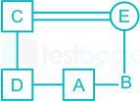
Secretive deduction type
A is B’s brother. C is D’s father. E is B’s mother. A and D are brothers. How is E related to C?
Explanation
(a) Sister
(b) Sister-in-law
(c) Niece
(d) Wife
(e) None of the above
ANS :
ANS : Wife

Slide 13
Secretive deduction type
Among her children, Ganga’s favourites are Ram and Rekha. Rekha is the mother of Sharat, who is loved most by his uncle Mithun, who is not the brother of ram. The head of the family is Ram Lal, who is succeeded by his sons Gopal and Mohan. Gopal and Ganga have been married for 35 years and have 3 children. What is the relation between Mithun and Mohan?
Explanation
(a) Uncle
(b) Brother
Mohan is son of Ram Lal and uncle of Ram and Rekha.
Mithun is uncle of Sharat who is son of Rekha.
Rekha is niece of Mohan. Therefore, Mithun is brother of Rekha’s husband. Hence, no blood relation between Mithun and Mohan.
(c) Father
(d) Son
(e) None of the above
ANS :
ANS : None of the above

Slide 14
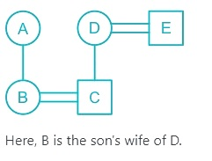
Coded relation type
K @ L means K is the husband of L
K & I means K is the mother of I
K # L means K is the son of L
If A & B @ C # D @ E, the how is B related to D?
Explanation
(a) Son’s wife
(b) Sister
(c) Mother
(d) Daughter
(e) None of the above
ANS :
ANS : Son’s wife

Slide 15
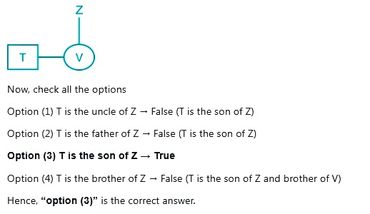
Coded relation type
‘R+S’ means ‘R is the daughter of S’. ‘R—S’ means ‘R is the husband of S’.R x S’ means ‘R is the brother of S’. If ‘T x V + Z, then which of the following options is true?
Explanation
(a) T is the uncle of Z
(b) T is the father of Z
(c) T is the son of Z
(d) T is the brother of Z
(d) None of the above
ANS :
ANS : T is the son of Z

Slide 16
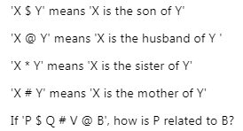
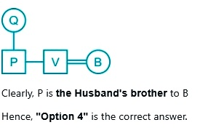
Coded relation type
Explanation
(a) Mother
(b) Son
(c) Father
(d) Husband’s brother
(d) None of the above
ANS :
ANS : Husband’s brother

Slide 17
Puzzle type
Eight persons in three generation of the family. K is daughter in law of G. M is father of L, who is daughter-in-law of P. H is brother-in-law of G and only son of F. T is grandson of F. H is unmarried. G is male. M has two child.
1. How is M related to G?
(a) Father (b) Brother (c) Father-in- law (d) Brother-in-law (e) None of these
2. How is K related to L?
(a) Daughter-in-law (b) Sister (c) Mother-in-law (e) Daughter
3. Who among the following is son of M?
(a) H (b) G(c) T (d) L (e) None of these
Notes:
C
A
T

Slide 18
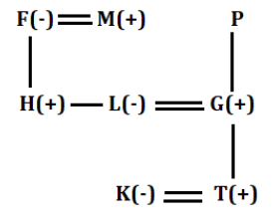
Explanation
ANS : Q1) Father-in- law
ANS : Q2) Daughter-in-law
ANS : Q3) H

Slide 19
Get the answers.
1. Pointing to a woman in a photograph a man says ‘‘she is the only daughter of my wife's mother-in-law." How is the woman related to the man?
(a) Daughter
(b) Wife
(c) Sister
(d) Sister-in-law
2. Sushant said "This girl is the wife of the grandson of my mother. How is Sushant to the girl?
(a) Father
(b) Grandfather
(c) Husband
(d) Father-in-law
Notes:
1.C
2.D

Slide 20
Get the answers.
1. F is the brother of A. C is the daughter of A, K is the sister of F. G is the brother of C. Who is the uncle of G?
(a) A
(b) C
(c) F
(d) K
2. A is the uncle of B, who is the daughter of C and C is the daughter-in-law of P. How is A related to P?
(a) (a) Brother
(b) Son
(c) Son-in-law
(d) None of these

Slide 21
Get the answers.
A & B means ‘A is mother of B’
A % B means ‘A is daughter of B’
A # B means ‘A is sister of B’
A $ S B means ‘A is son of B’
If U & T & K # C % Z $ S, then how is T related to S?
(a) Son’s daughter
(b) Daughter’s Husband
(c) Son’s wife’s mother
(d) Son’s wife
Notes:
D

Slide 22
Puzzle type
Six members of a family namely A, B, C, D, E and F are travelling together. ‘B’ is the son of C but C is not the mother of B. A and C are married couple. E is
the brother of C. D is the daughter of A. F is the brother of B. How many male members are there in the family?
(a) 1
(b) 2
(c) 3
(d) 4
(e) None of the above

Slide 23

THANK YOU

